Slide 1
South Bay Workforce Investment Board
Employment Training Panel (ETP) Multiple Employer Contract (MEC)
ETP Contract #ET22-0136
Participating Employer Instructions
Key Dates / Term:
ETP Contract Term: 11/22/2021 - 11/21/2023
Training Period: 11/22/2021 - 8/23/2023
(last three months of contract set aside for retention)
Training can go back to 11/22/2021 if properly documented.
Employee Eligibility:
Must be your full-time workers (35 hours or more per week) during the 90-days following training (the retention period) and during this retention period, they must make at least $15.00-$19.12 (depending on the county where they work)
Must be in an eligible job classification/function or job family based on those included in the grant:
Operations, Manufacturing, Logistics/Warehouse/Distribution
Engineering/IT Staff, Sales/Marketing Staff
Quality Assurance Staff
Supervisor/Manager
Registered Nurse, Licensed Vocational Nurse, Therapist/Technician/Phlebotomist
Dental Assistant

Slide 2
Participating Employer Instructions Continued
Training Eligibility:
Trainees must receive between 8 and 200 hours to be eligible for participation in the contract (See approved ETP MENU Curriculum – list of training subject matters, not meant to be an exhaustive list of class titles)
Eligible trainers include in-house instructor/subject matter expert, SBWIB contract trainer, and outside training vendor (all external vendors must be paid for the training to be eligible to be reimbursed)
Rosters must be completed with all course details and trainer and trainee signatures – see attached roster samples
SBWIB uses a third-party administrator to assist with grant compliance – Training Funding Partners
Employee human resource data must be provided for all trainees participating in the SBWIB ETP Project (data is transferred via secure ShareFile to Training Funding Partners - all data is encrypted while in transit, while at rest, and during the backup process) - see slide 4 for required data fields
ETP rosters (noted above) must be scanned and emailed directly to TFP for processing
Once training begins and you have your first rosters completed, SBWIB will introduce you to TFP to set up your secure ShareFile account for the submission of employee information and roster transmission.
If training is not going to begin within 30-days of your ETP Certification statement date, please contact XXXX at the SBWIB.

Slide 3
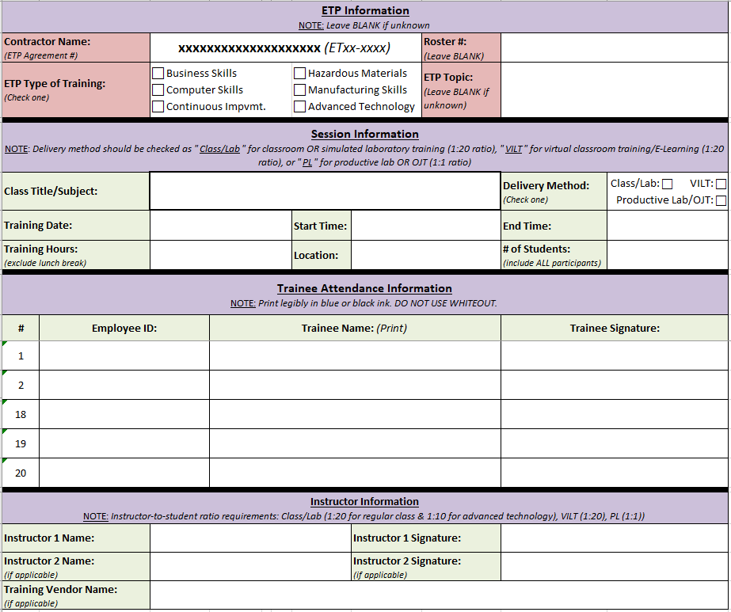
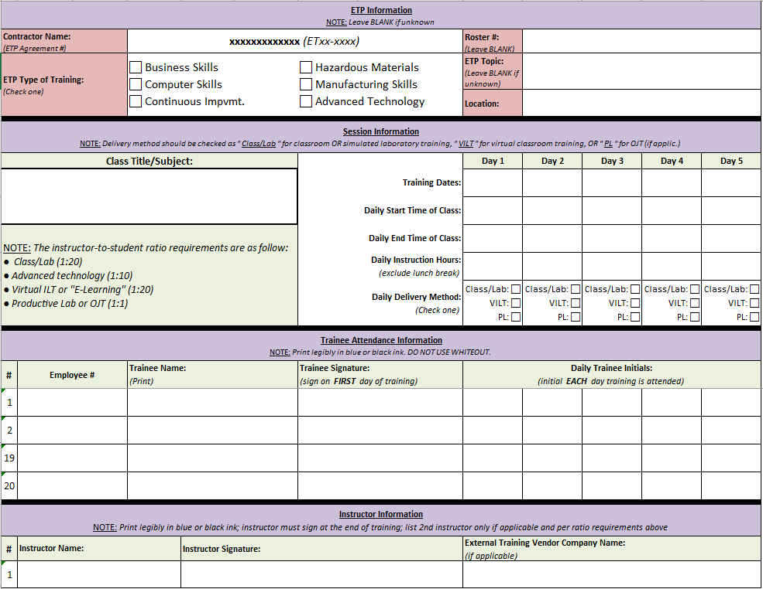
ETP ROSTERS
Class attendance for each day of instructor-led training (Class/Lab/OJT) must be documented using a roster that contains ETP-required fields.
01
ETP reimburses by the trainee hour therefore tracking instructional time for each trainee and confirming that through the collection of trainee and trainer signatures is mandatory.
02
Single and Multiple-Day Roster Formats Available.

Slide 4
HR DATA REQUIRED FROM EMPLOYER
Required for ETP Enrollment & Eligibility Determination | Other Data If and When Applicable
Employer Company Name | Termination Date
Employee ID | Employer Paid Health Benefits
Social Security Number (1x use at enrollment)
Trainee Name (First & Last)
Job Title
Hire Date
Gender
Age
Hourly Wage (non-OT)
Home Zip Code
Ethnicity
Education Level
Employment/Payroll Status
Office Location
TFP also supports other forms of secure transfer such as SFTP
TFP’s ShareFile Website
Send with 128-bit encryption

Slide 5
TRANSMISSION METHODS
ROSTERS
Email to Dana Lavin of TFP at accounting@tfpgroup.com
HR DATA
Encrypted Data Transfer at:
TFP ShareFile Site
tfpgroupupload.sharefile.com

